Slide 1
Web development
D a y 4
By Rajdeep Karmakar

Slide 2
Today’s Topics:
1. Connect Git with Github and First code push in github
2. Structure of HTML

Slide 3
01
Connect Git with GIthub
and First code push in github

Slide 4
Connect Git with Github and First code push in github:
1. Set up Git:
First, configure Git with your name and email. Open a terminal or command prompt and run:
git config --global user.name "Your Name"
git config --global user.email "your.email@example.com"
2. Set up GitHub Account and Create a Remote Repository:
Go to GitHub and log into your account (If signed out).
Click the + icon at the top right and select New repository.
Name your repository, and decide whether you want it to be public or private.
Do not initialize the repository with a README file, .gitignore, or license.
Click Create repository.

Slide 5
Connect Git with Github and First code push in github:
3. Connect Local Git Repository to GitHub:
In your terminal, go to your local repository folder (where you've already initialized Git) and connect it to the newly created GitHub repository by adding the remote origin.
You can copy the repository URL (HTTPS or SSH) from GitHub (from the repository page, click the Code button, and copy the link).
Now, link your local repository to GitHub:
git remote add origin https://github.com/your-username/your-repo.git
(For HTTPS)
or
git remote add origin git@github.com:your-username/your-repo.git
(For SSH)

Slide 6
Connect Git with Github and First code push in github:
4. Push Local Repository to GitHub:
Once the remote repository is connected, push your local commits to GitHub.
Run the following command to push everything in your local repository to the remote repository:
git push -u origin master
If your local repository branch is called something other than master, use that branch name instead.
For example, if it's main:
git push -u origin main
4. Verify on GitHub:
After running the git push command, your local repository will be published on GitHub. You can verify this by refreshing your GitHub repository page.

Slide 7
02
Structure of HTML

Slide 8
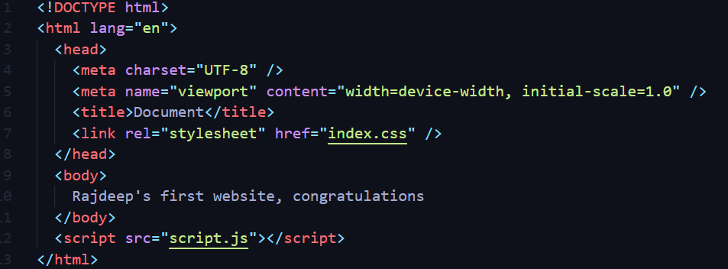
Structure of HTML
HTML
tags
Boilerplate
code
content
what you want to show, write inside the <body></body>

Slide 9


